Slide 1


Slide 2




Calcoholics
Maharaja Agrasen Institute of Technology
Graduation year - 2022
Tanya Gupta, Shubham Naudiyal, Deepanshu Vats, Utkarsh Srivastava
Tanya Gupta
Shubham Naudiyal
Deepanshu Vats
Utkarsh Srivastava

Slide 3
GROSS SALES
According to the actual gross sales indicated in blue, till 2008Q1, distributor firm is clocking good sales. 2008Q1 showed a 3-year high. Sales showed a downward trend but they aren’t alarming. Gross sales are almost achieving the targets as per the forecasting.
After 2009Q1, the two quarters are showing a considerable drop in gross sales. This could be attributed to the Financial crisis caused by Lehman brother’s bankruptcy which hit the US market and affected whole world in its wake.
In 2009Q4, market is recovering from the shock caused by the crisis. Firm’s sales has also appreciated which means distributor’s products still have their hold in market and can survive this pullback by crisis and can do well in future.
Overall, Distributor company shows a promising and organic growth and will evidently do well going ahead.

Slide 4
GROSS PROFIT %
In all four quarters of 2007, it is observed that the sales are not fetching adequate Return on Investment(ROI). Though, 39.85 % is a good Gross profit but it is the lowest of the given quarters.
The revenue jump in 2008Q1 is valuing at about ~18% has caused the gross profit % to surge by a considerable mark. However, the expectations mentioned in the budget are not being met.
Revenue loss in 2009Q2 & 2009Q3 when calculated aggregately would be ~17% has forced the budget inflection point of 2009Q4 to plummet by a big margin but the revenue clocked exceeded the forecasting.
From a broader perspective, gross profit % has been swelling at a steady rate, indicating that the sales have been profitable and the market shows a natural pull towards the products.

Slide 5
Domestic V/S International Sales
Despite the international market comprising 4 countries(IRE, UK, CA, AU), the sales in Domestic and International market throughout the timeline are not considerably different.
The sales in the international market over a period of 3 years are unvarying. It can be derived that the firm’s products are not reaching high potential market available internationally, owing to the mere 336 Customer Keys of a total of 684.

Slide 6
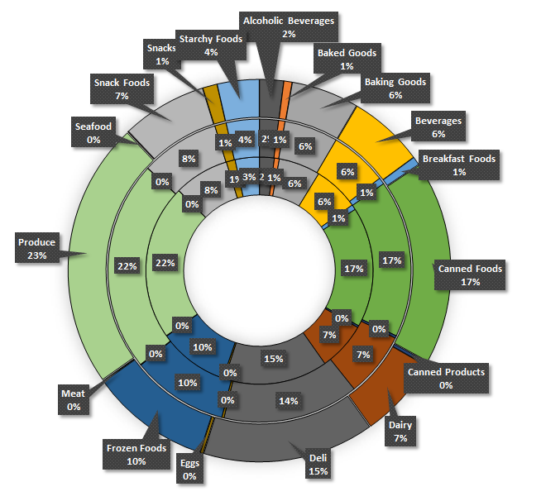
Sales according to Product
Major chunk of revenue is brought-in primarily by Produce, along with Canned foods and Deli. Whereas, sales of canned products, seafood, meat and eggs stream in low influx of revenue.
There is stagnancy in product revenue composition. A prominent expansion of consumer base is not visible.
Innermost donut-2007
Middle donut- 2008
Outermost donut-2009

Slide 7
Sales in US regions
Central America draws-in the most sales revenue despite being the least densely populated area. Firm’s distributive network is well established in the region with 117 distinct Customer Key(s).
Despite being a high population density region with a potential for a huge customer base, our performance is subpar. However, there is steady growth amongst the 42 Customer Keys there. Allocation of resources for better networking could be a solution.
A drop in sales across all regions in 2009 FY could be attributed to the great recession of 2008.

Slide 8
Performance of Sales Representatives
Year | Sales(Above Average) | Sales Margin(Above Average)
2007 | 19 | 18
2008 | 18 | 19
2009 | 19 | 19
In 2007, it is observed that out of 64 sales representatives spread across different regions, only 19 are clocking sales higher than the mean calculated. Out of which 18 have appreciable sales margins. The transition in the number of representatives showing high yielding sales are cited in the given table.
Throughout the timeline, Sales Representative who performed consistently exceptional comes out to be Judy Thurman(Sales Rep 141) and the worst performing is Lisa Taylor(Sales Rep 150).
(Table mentioned above is showing number of representatives with promising sales and sales margin.) Total representatives =64

Slide 9
Anything Else?
At various instances of time, products were handed out at hefty discounts and even at 0 sales amount as samples or maybe for promotional strategies. However, their impact on sales numbers cannot be ignored. Some regulatory strategies must be employed by the firm to keep these losses in check.
Analysis of data for different regions of every country could be evaluated to give a better view of international sales. However, data regarding countries of 129 “Address Numbers” was absent.

Slide 10
THANK YOU

